Slide 1
Text Summarizer USIng Machine learning
Under the supervision of Dr. Mustafa Abdul-Salam

Slide 2
Hello!
I am Awad Safwat
I am here because I hope to give a goode presentations about my graduation project :
(text summarizer App)

Slide 3
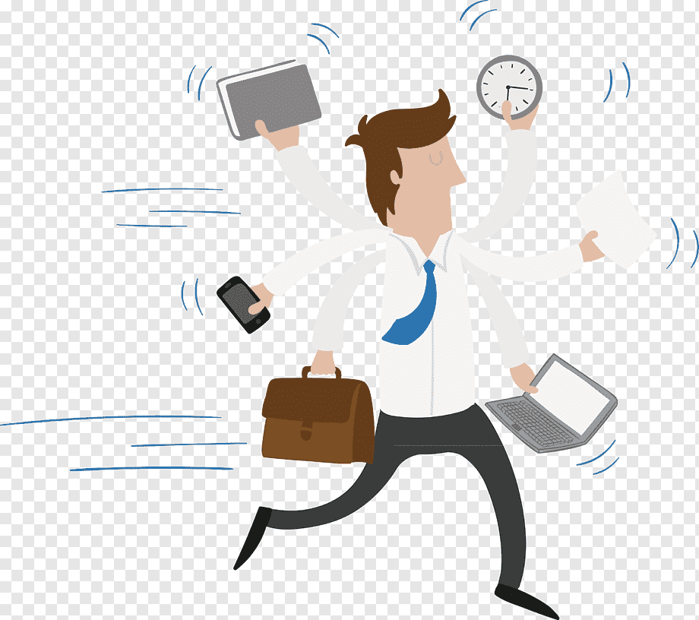

1.
Short story Ahmed
Before
After

Slide 4
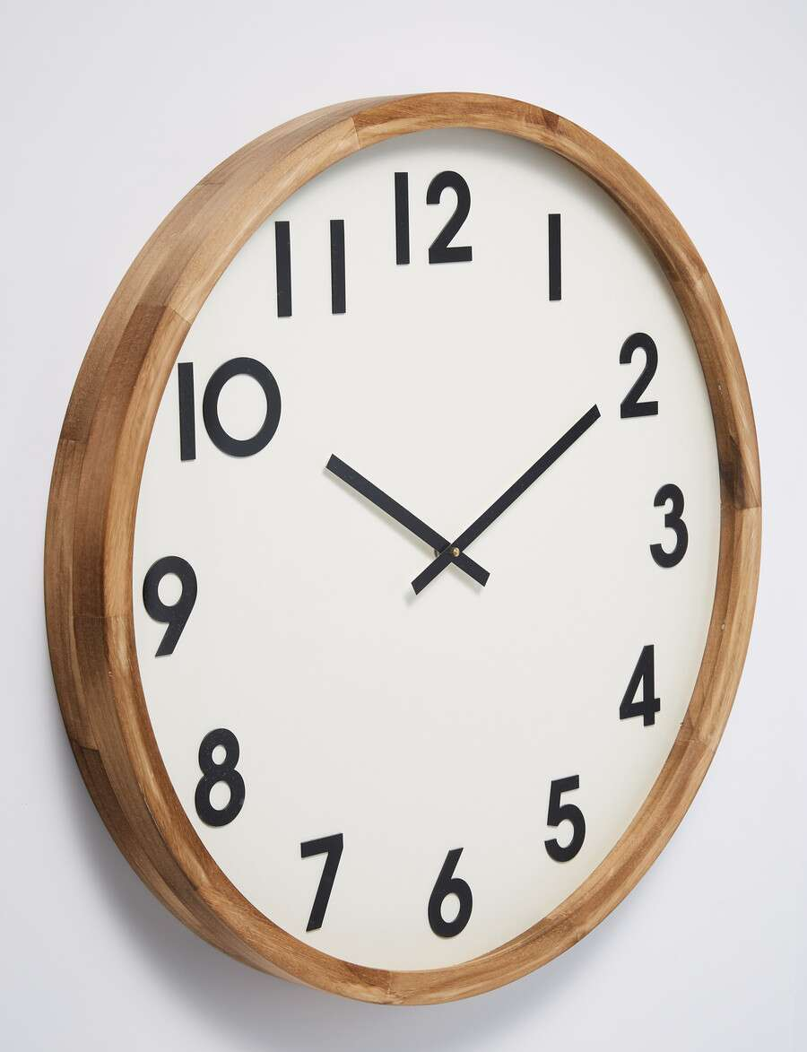
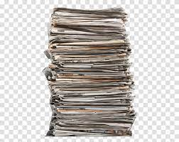
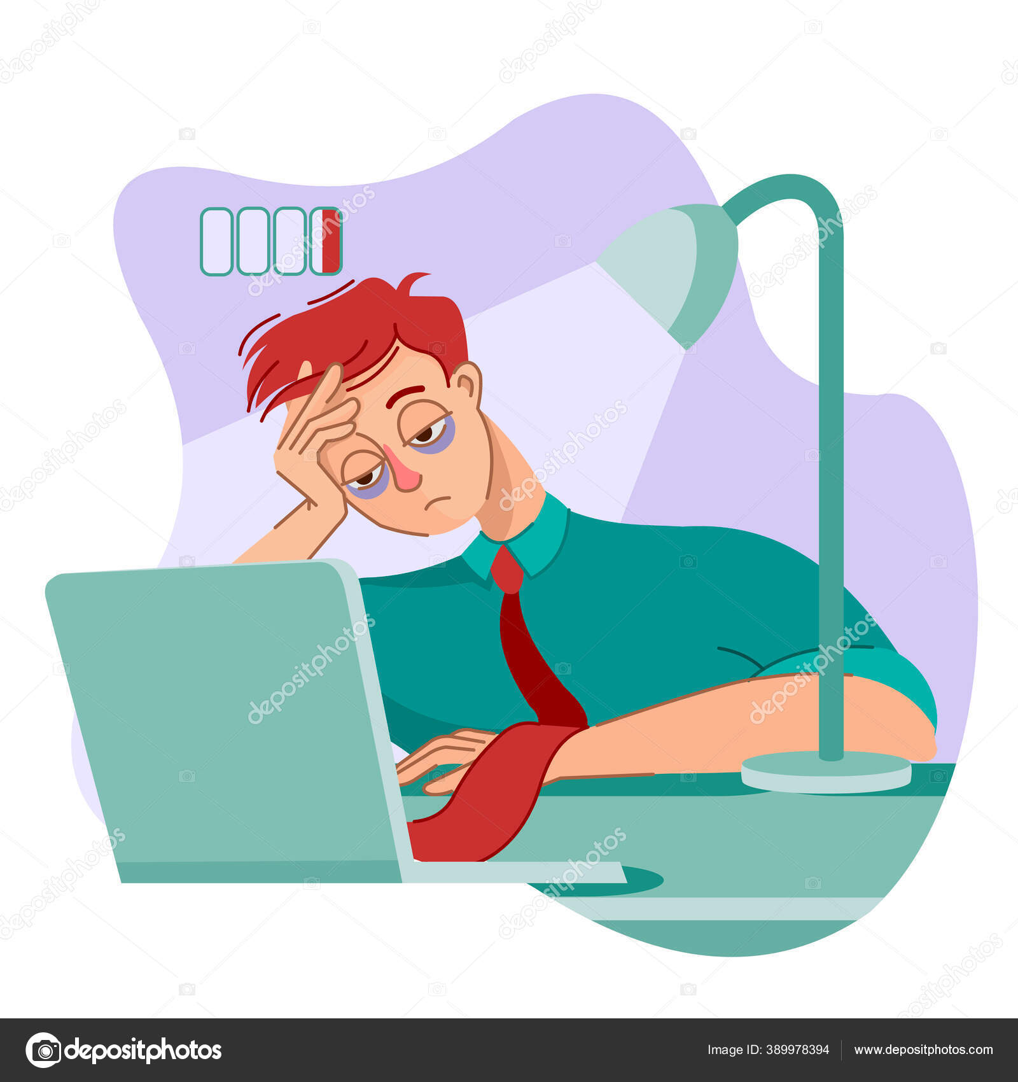
Problems:
Daily multitasking:
The time available does not match the required tasks:
Lots of information sources:
Exerting more mental and physical effort:

Slide 5
Objectives :
Try to reduce the size of the tasks :
Save some time for the user:
Helping the user to find as many sources as possible in the shortest possible time:
Reduce user effort:

Slide 6
Solutions :
The ability to summarize texts with high accuracy:
There is more than one way to enter text
(scan text using the camera \ upload a text file):
Enable the text-to-speech feature in the program:

Slide 7
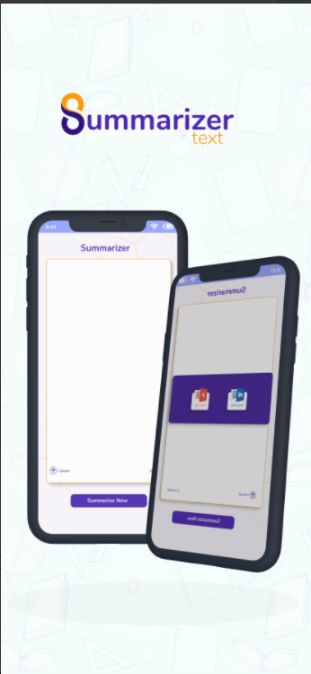
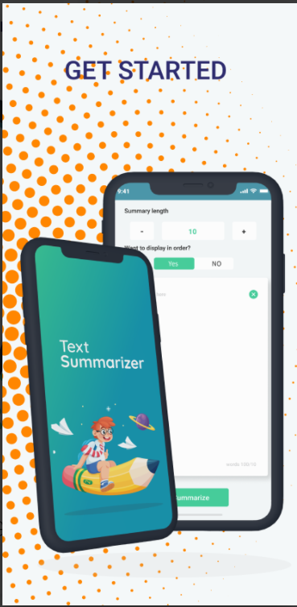
Similar applications
Text Summarizer_AI
Text Summarizer

Slide 8
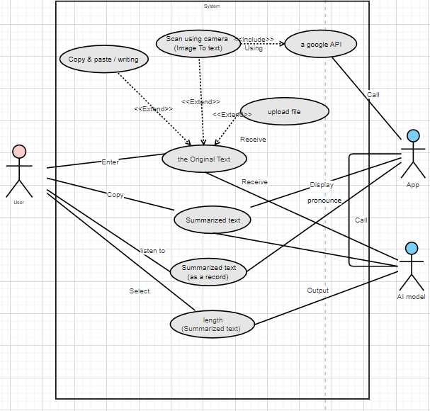
UseCase Diagram

Slide 9
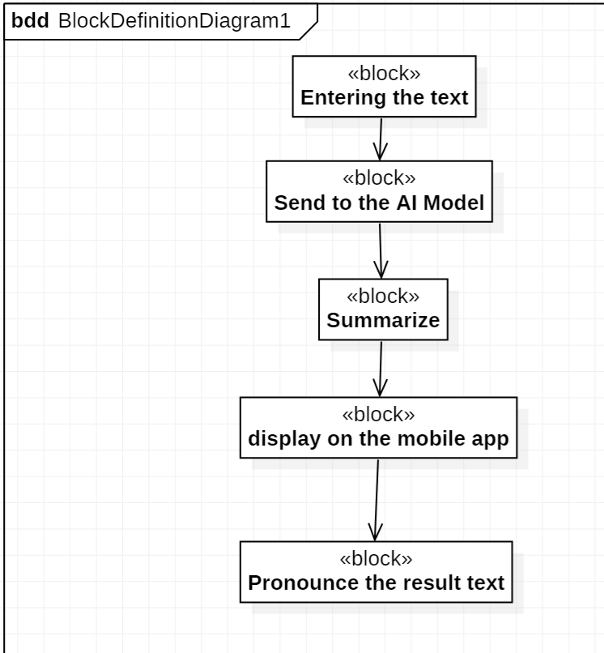
Block Diagram

Slide 10
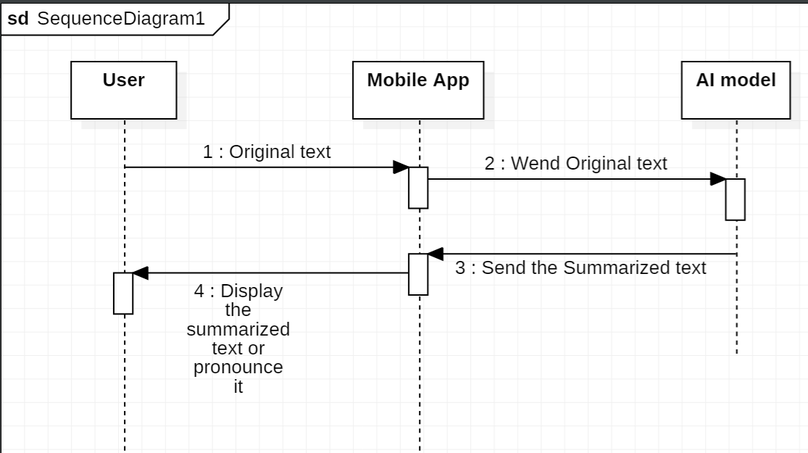
Sequence Diagram

Slide 11
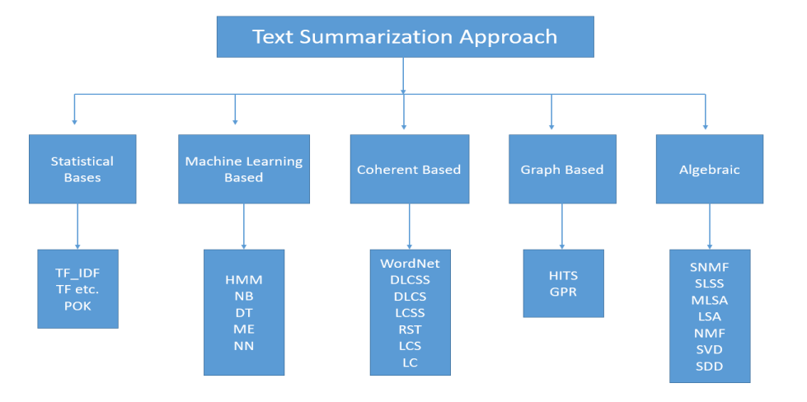
TEXT SUMMARIZATION APPROACHES
And it’s algorithms

Slide 12
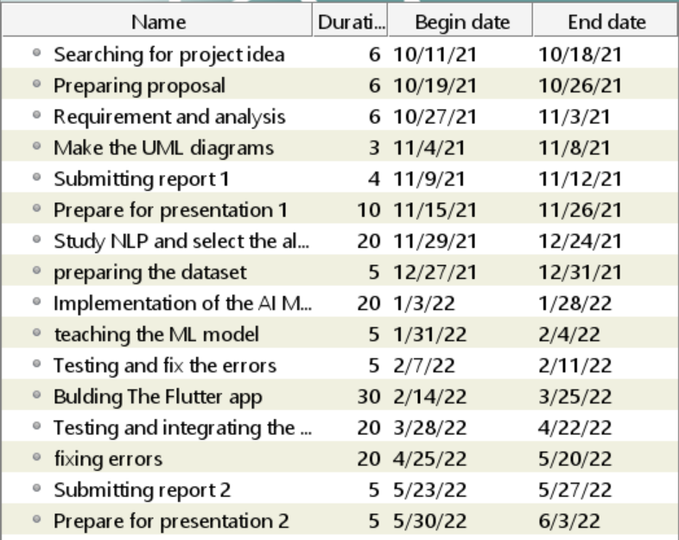
Timeline

Slide 13
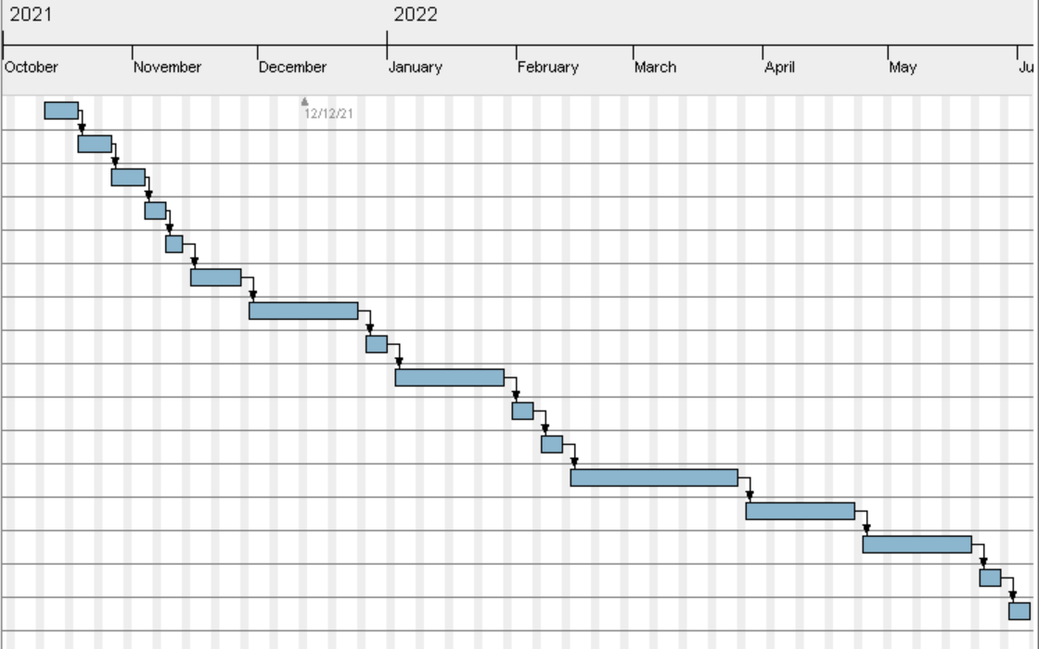
Gantt Chart

Slide 14
Thanks!
Any questions?
You can find me at:
Awad.Safwat@gmail.com

